Slide 1
COVID IN NIGERIA
Distribution, death rate AND effect on the gdp
Summary

Slide 2
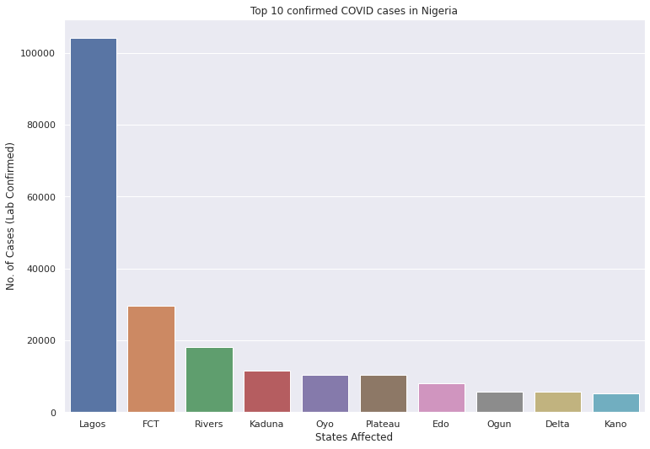
Top 10 states with confirmed cases

Slide 3
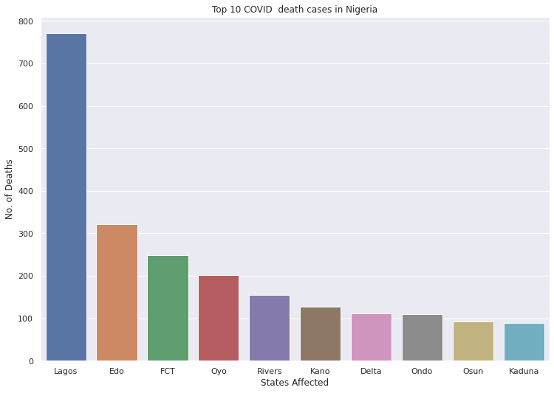
TOP 10 STATES WITH COVID DEATHS

Slide 4
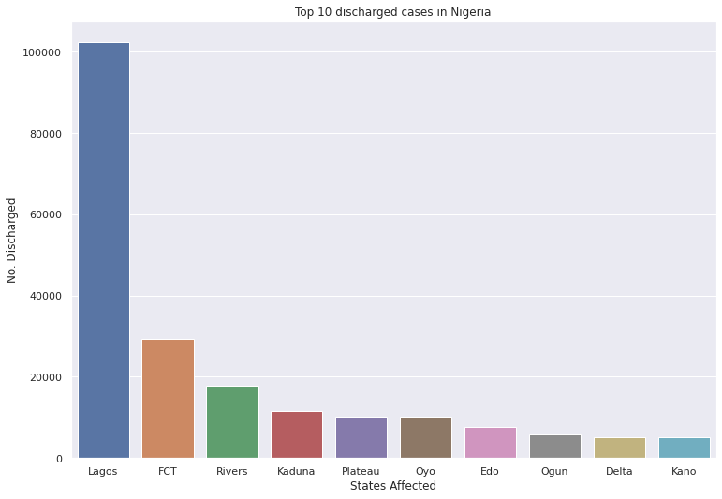
TOP 10 STATES WITH DISCHARGED PATIENTS

Slide 5
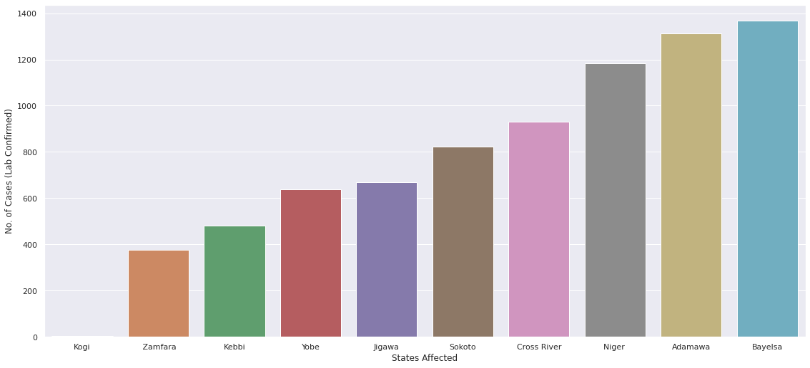
THE 10 LEAST AFFECTED STATES

Slide 6
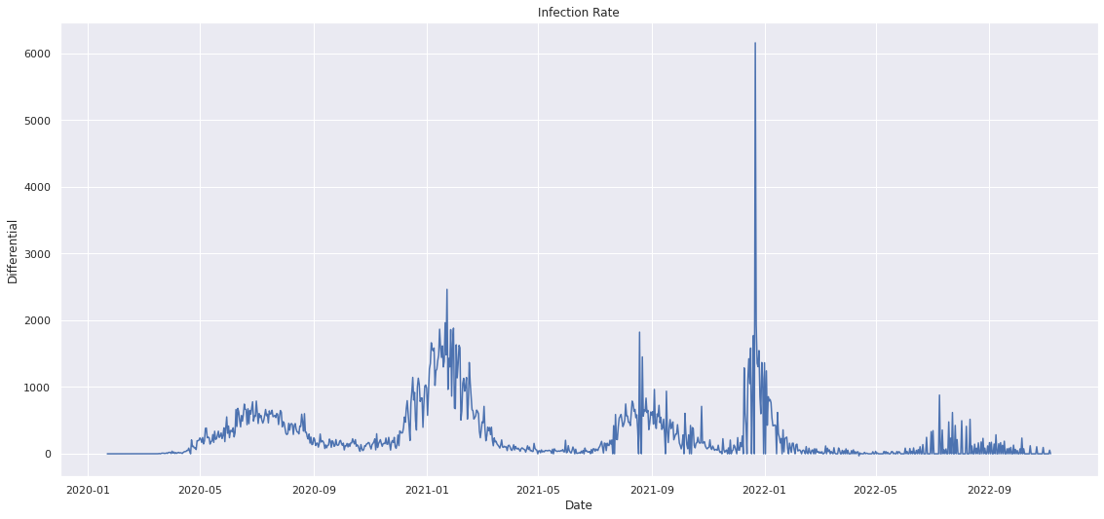
DAILY INFECTION RATE

Slide 7
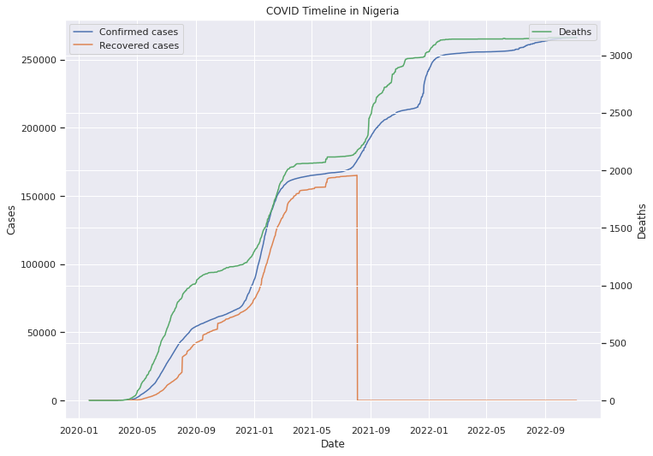
INFECTION TIMELINE

Slide 8
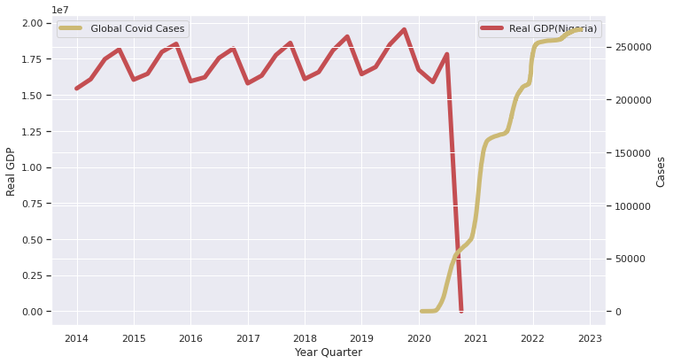
REAL GDP VS COVID EMERGENCE

Slide 9
SUMMARY
Lagos has the highest COVID Infections and deaths
22nd December, 2021 had the highest number of daily infections with a record of 6158 cases.
The GDP declined with the emergence of the pandemic
The vulnerability index by itself is not a good predictor of infection volume
The elderly are by far more likely to require acute care after infection
Higher population density regions have more infections
1% of infected patients died
97.5% of infected patients were discharged
Kogi suffered the least damage from COVID with 5 confirmed cases

